Slide 1
Using Quotations in Writing

Slide 2
We use quotation marks to enclose a person’s direct words.
According to the article, “Many students are carrying too much weight in their backpacks.”
The article says that students backpacks are too heavy.
Article’s actual words
Not exact words from article…paraphrased

Slide 3
Begin quote with capital letter, unless it is a continuation of your sentence.
A student at Central Magnet states, “My backpack weighs 30 pounds on average.”
Complete sentence is quoted…begin with a capital
A student at Central Magnet notes that his backpack “weighs 30 pounds on average.”
Quoted words are not a complete sentence on their own…they continue what the writer is saying…no capital needed.

Slide 4
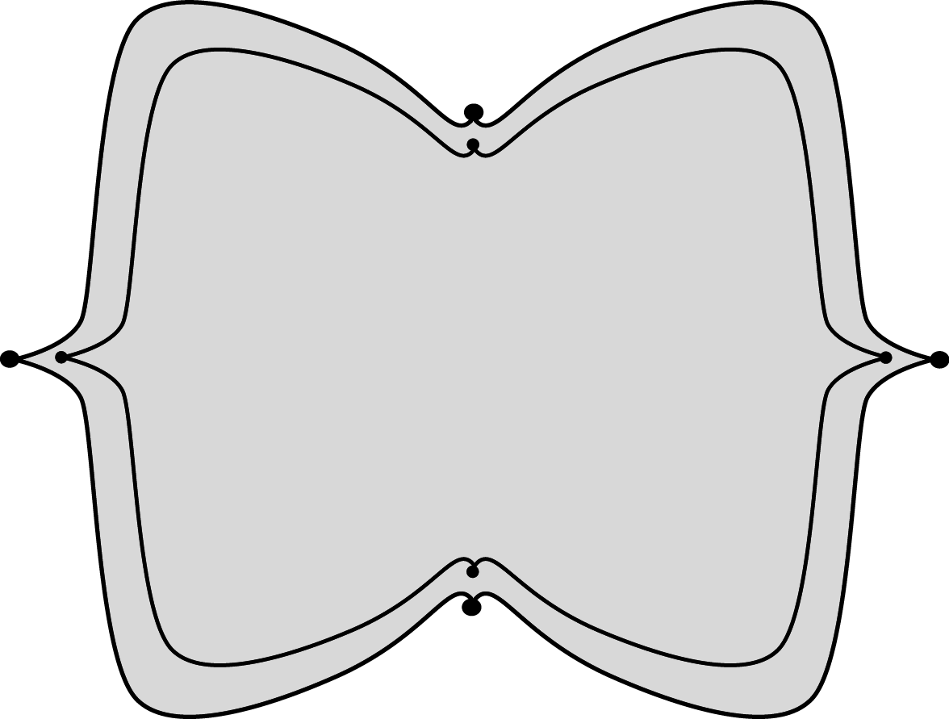
Broken Quotations (identification of speaker/source comes in the middle of the quote.)
“Backpack weight has always been a concern of mine,” says parent April Davis, “and I hope that teachers will take students’ health into consideration when assigning homework that requires multiple text books.”
Quote is divided
First word of quote is capitalized, but first word of continuation of quote is not.
Commas are placed after first part of quote INSIDE QUOTATION MARKS and after identification of speaker/source

Slide 5
Punctuation goes…
Inside quotation marks with a period at the very end
“I think having textbooks online will help,” commented one teacher.
“Do you think having online textbooks will help?” I asked.
“Put that textbook back in your locker!” he shouted.

Slide 6
Punctuation goes…
Before quotation marks with sentence punctuation at the very end inside quotation marks
One teacher commented, “I think having online textbooks will help.”
I asked, “Do you think online textbooks will help?”
He shouted, “Put your book in your locker!”

Slide 7
Punctuation goes…
Before quotation marks
“In my opinion,” commented one teacher, “having online textbooks will help.”
“Did you check the board,” asked my mom, “and get all the books you need?”

Slide 8
Questions and Exclamations
? and ! go INSIDE the quotation marks if the quotation is a question or exclamation
If the quotation itself is NOT a question or exclamation, the ? and ! go OUTSIDE the quotation marks.
INSIDE
OUTSIDE
“Did you get your book?” asked my mom.
“Jump!” ordered the firefighter.
Who said, “Don’t forget your book”?
I couldn’t believe he said, “No, thank you”!

Slide 9
Single quotation marks are used to show a quotation within a quotation.
What Charlie said
Charlie added, “My mom always tells me, ‘Double check your backpack before leaving school.’”
What Charlie’s mom said

Slide 10
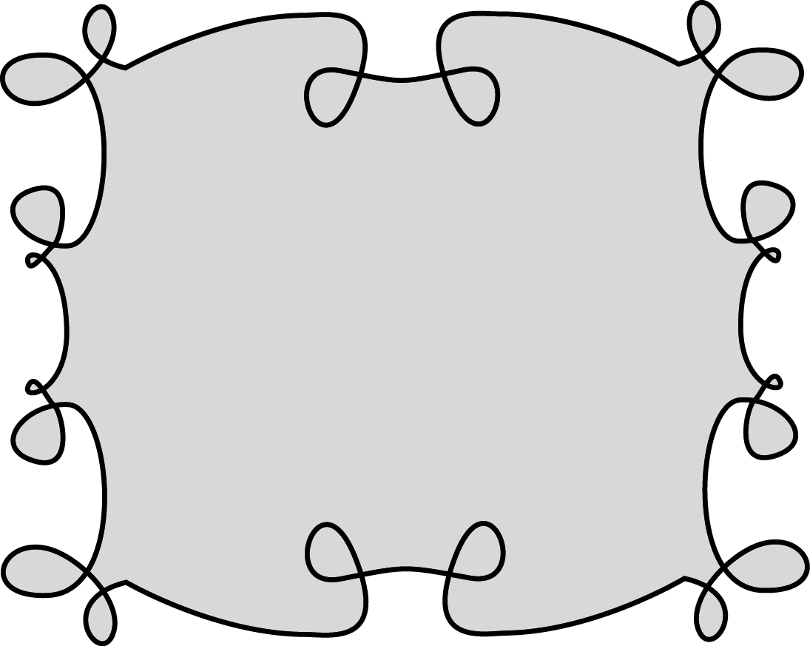
Short stories poems songs TV Episodes Essays Articles Chapters in a book Section Titles

